Slide 1
POWERPOINT PRESENTATION - PHYSICS
TOPIC – CHARGING MOBILE WITH WATER DROPLETS

Slide 2
GETTING A CHARGE OUT OF WATER DROPLETS
Water condensing and jumping from a superhydrophobic surface can be harnessed to produce electricity.
MIT researchers discovered that when water droplets spontaneously jump away from superhydrophobic surfaces during condensation, they can gain electric charge in the process. Now, the same team has demonstrated that this process can generate small amounts of electricity that might be used to power electronic devices.

Slide 3
THE FINDING The new findings, by postdoc Nenad Miljkovic, associate professor of mechanical engineering Evelyn Wang, and two others, are published in the journal Applied Physics Letters. This approach could lead to devices to charge cellphones or other electronics using just the humidity in the air. As a side benefit, the system could also produce clean water. The device itself could be simple, Miljkovic says, consisting of a series of interleaved flat metal plates. Although his initial tests involved copper plates, he says any conductive metal would do, including cheaper aluminum. In initial testing, the amount of power produced was vanishingly small — just 15 picowatts, or trillionths of a watt, per square centimeter of metal plate. But Miljkovic says the process could easily be tuned to achieve at least 1 microwatt, or millionth of a watt, per square centimeter. Such output would be comparable to that of other systems that have been proposed for harvesting waste heat, vibrations, or other sources of ambient energy, and represents an amount that could be sufficient to provide useful power for electronic devices in some remote locations. For example, Miljkovic has calculated that at 1 microwatt per square centimeter, a cube measuring about 50 centimeters on a side — about the size of a typical camping cooler — could be sufficient to fully charge a cellphone in about 12 hours. While that may seem slow, he says, people in remote areas may have few alternatives.

Slide 4
There are some constraints: Because the process relies on condensation, it requires a humid environment, as well as a source of temperatures colder than the surrounding air, such as a cave or river.
False-color time-lapse images captured via high-speed imaging show a droplet jumping (colored green) from a superhydrophobic copper oxide fin to a hydrophilic (water-attracting) copper fin (colored orange). (Courtesy of Nenad Miljkovic and Daniel J. Preston)

Slide 5
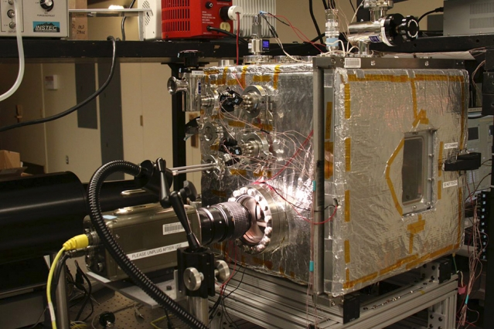
The experimental chamber setup is seen from the front, with high speed camera looking into the chamber from the left.
The system is based on Miljkovic and Wang’s 2013 finding — in attempting to develop an improved heat-transfer surface to be used as a condenser in applications such as power plants — that droplets on a superhydrophobic surface convert surface energy to kinetic energy as they merge to form larger droplets. This sometimes causes the droplets to spontaneously jump away, enhancing heat transfer by 30 percent relative to other techniques. They later found that in that process, the jumping droplets gain a small electric charge — meaning that the jumping, and the accompanying transfer of heat, could be enhanced by a nearby metal plate whose opposite charge is attractive to the droplets.
Now the researchers have shown that the same process can be used to generate power, simply by giving the second plate a hydrophilic surface. As the droplets jump, they carry charge from one plate to the other; if the two plates are connected through an external circuit, that charge difference can be harnessed to provide power.
In a practical device, two arrays of metal plates, like fins on a radiator, would be interleaved, so that they are very close but not touching. The system would operate passively, with no moving parts.

Slide 6
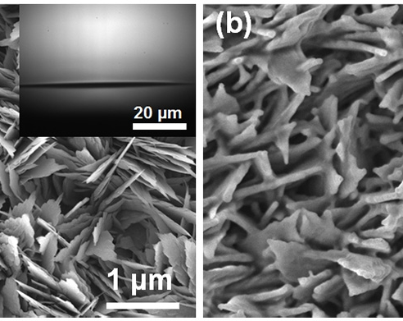
Images from a field emission scanning electron microscope show (left) an oxidized copper-oxide surface and (right) a copper-oxide surface with a 30 nanometer-thick hydrophobic coating. The inset images show a water droplet on the surface: At left, the droplet spreads out to wet the uncoated surface; at right, the droplet beads up on the hydrophobic surface, making very little contact.

Slide 7
POWERING UP
For powering remote, automated environmental sensors, even a tiny amount of energy might be sufficient; any location where dew forms would be capable of producing power for a few hours in the morning, Miljkovic says. “Water will condense out from the atmosphere, it happens naturally,” he says.
“The atmosphere is a huge source of power, and all you need is a temperature difference between the air and the device,” he adds — allowing the device to produce condensation, just as water condenses from warm, humid air on the outside of a cold glass.
Chuanhua Duan, an assistant professor of mechanical engineering at Boston University who was not involved in this research, says, “This work provides a new approach for energy-harvesting, which can be used to power [microelectromechanical] devices and small electronic devices.” He adds, “Getting power from a condensation process is definitely a novel idea, as condensation is mainly used for thermal management. … Recent studies of condensation on superhydrophobic surfaces [have] extended its applications in self-cleaning and anti-icing, but no one has correlated condensation with energy-harvesting before.”

Slide 8
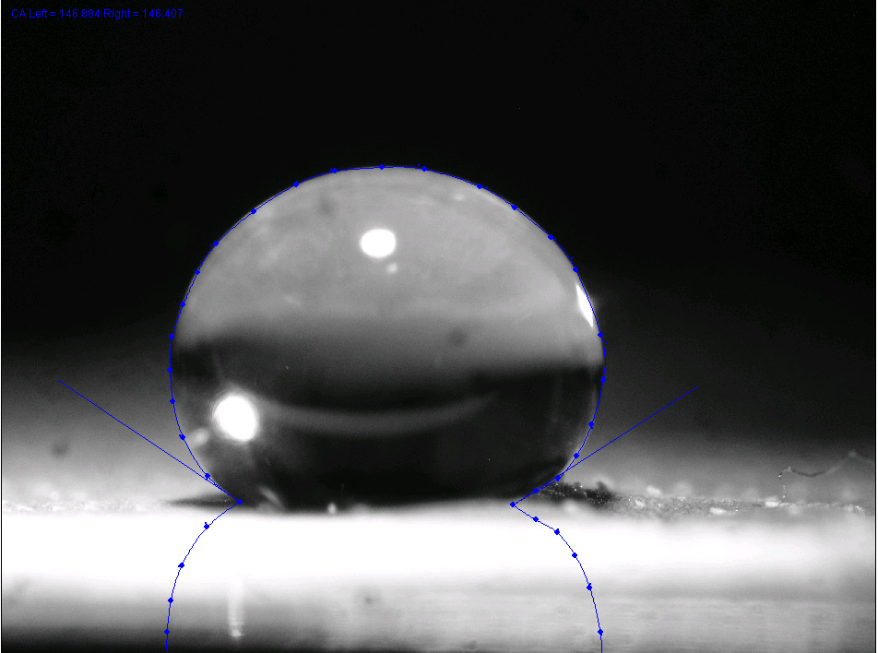
SUPERHYDROPHOBIC Ultrahydrophobic (or superhydrophobic) surfaces are highly hydrophobic, i.e., extremely difficult to wet. The contact anglesof a water droplet on an ultrahydrophobic material exceed 150°.^{[1]} This is also referred to as the lotus effect, after the superhydrophobic leaves of the lotus plant. A droplet impacting on these kinds of surfaces can fully rebound like an elastic ball,^{[2][3]} or pancake.^{[4]}
A drop on a lotus surface

Slide 9
Theory In 1805, Thomas Young defined the contact angle θ by analysing the forces acting on a fluid droplet resting on a solid surface surrounded by a gas.^{[5]} A liquid droplet rests on a solid surface and is surrounded by gas. The contact angle, θ_{C}, is the angle formed by a liquid at the three phase boundary where the liquid, gas, and solid intersect. A droplet resting on a solid surface and surrounded by a gas forms a characteristic contact angle θ. If the solid surface is rough, and the liquid is in intimate contact with the solid asperities, the droplet is in the Wenzel state. If the liquid rests on the tops of the asperities, it is in the Cassie-Baxter state. Wenzel determined that when the liquid is in intimate contact with a microstructured surface, θ will change towhere r is the ratio of the actual area to the projected area.^{[6]} Wenzel's equation shows that microstructuring a surface amplifies the natural tendency of the surface. A hydrophobic surface (one that has an original contact angle greater than 90°) becomes more hydrophobic when microstructured – its new contact angle becomes greater than the original. However, a hydrophilic surface (one that has an original contact angle less than 90°) becomes more hydrophilic when microstructured – its new contact angle becomes less than the original.^{[7]} Contact angle is a measure of static hydrophobicity, and contact angle hysteresis and slide angle are dynamic measures. Contact angle hysteresis is a phenomenon that characterizes surface heterogeneity.^{[11]} When a pipette injects a liquid onto a solid, the liquid will form some contact angle. As the pipette injects more liquid, the droplet will increase in volume, the contact angle will increase, but its three phase boundary will remain stationary until it suddenly advances outward. The contact angle the droplet had immediately before advancing outward is termed the advancing contact angle. The receding contact angle is now measured by pumping the liquid back out of the droplet. The droplet will decrease in volume, the contact angle will decrease, but its three phase boundary will remain stationary until it suddenly recedes inward.

Slide 10
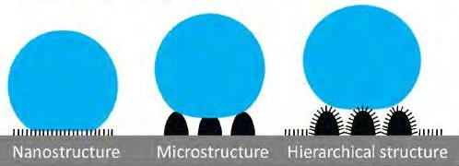
Unitary versus hierarchical roughness structures
M. Nosonovsky and B. Bhushan studied the effect of unitary (non-hierarchical) structures of micro and nano roughness, and hierarchical structures (micro roughness covered with nano roughness).^{[13]} They found that hierarchical structure was not only necessary for a high contact angle but essential for the stability of the water-solid and water-air interfaces (the composite interface). Due to an external perturbation, a standing capillary wave can form at the liquid–air interface. If the amplitude of the capillary wave is greater than the height of the asperity, the liquid can touch the valley between the asperities; and if the angle under which the liquid comes in contact with the solid is greater than h0, it is energetically profitable for the liquid to fill the valley. The effect of capillary waves is more pronounced for small asperities with heights comparable to the wave amplitude. An example of this is seen in the case of unitary roughness, where the amplitude of asperity is very low. This is why the likelihood of instability of a unitary interface will be very high.

Slide 11
That’s the way the droplets adhere
Understanding exactly how droplets and bubbles stick to surfaces — everything from dew on blades of grass to the water droplets that form on condensing coils after steam drives a turbine in a power plant — is a “100-year-old problem” that has eluded experimental answers, says MIT’s Kripa Varanasi. Furthermore, it’s a question with implications for everything from how to improve power-plant efficiency to how to reduce fogging on windshields.
Now this longstanding problem has finally been licked, Varanasi says, in research he conducted with graduate student Adam Paxson that is described this week in the journal Nature Communications. They achieved the feat using a modified version of a scanning electron microscope in which the dynamic behavior of droplets on surfaces at any angle could be observed in action at high resolution.
Previous attempts to study droplet adhesion have been static — using drops of a polymer that are allowed to harden and then sliced in cross-section — or have been done only at very low resolution. The ability to observe the process in close-up detail and in full motion is an unprecedented feat, says Varanasi, the Doherty Associate Professor of Ocean Utilization.

Slide 12
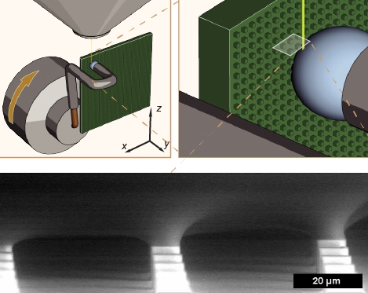
An illustration of the setup that MIT researchers used to image the tiny 'necks' that form where a droplet contacts a surface. The image at the bottom shows the base of an actual water droplet moving across the surface and was taken using a special scanning electron microscope.

Slide 13
THANK YOU BY – ADITYA CLASS – XII – B ROLL NO. 01

